Slide 1

MFAI PROJECT_PPT FOR MID SEMESTER ASSESSMENT- MARCH-26
Computer Network
PROJECT_TITLE:-Real-Time Early Network Traffic Classification
Div:- AIDS B EDAI_GROUP No:- 07 Day:- Monday Date:- 27/04/2026
Presented By :
1) Shourya Desai (12411254)
2) Vardhan Dhavale (12413236)
3) Payal Dhaygude (12414479)
4) Saumya Dhorje (12413161)
5) Ananya Gaikwad (12414493)
Project Guide :
Prof. Minal Barhate
DEPARTMENT OF ARTIFICIAL INTELLIGENCE AND DATA SCIENCE (AIDS)
VISHWAKARMA INSTITUTE OF TECHNOLOGY, PUNE

Slide 2
PROBLEM STATEMENT
The Latency Gap:
Attackers exploit systems within seconds
Traditional IDS require longer analysis time
Delay leads to increased vulnerability
The Flow Dependency Issue:
Detection depends on complete traffic flows
Early-stage signals are ignored
Results in late identification of threats
The Real-Time Deficit:
Limited ability to process live traffic
Most systems rely on offline datasets
Lack of continuous monitoring
The Accuracy Illusion:
High accuracy in controlled environments
Poor performance in real-world scenarios
Imbalance in training data affects results
Notes:
“When we looked at existing research, we found that most work depends on large models or focuses on just one technique at a time.
Very little research explores small-model pipelines, even though they are more practical for real-world deployment.
And structured JSON extraction from varied resumes — especially medical resumes — is still an underexplored area.
So the key gap we address is this:
How can we achieve accurate, consistent, and valid JSON extraction using a small, domain-specific language model across highly varied resume formats?
Our project attempts to fill exactly this gap.”

Slide 3
INTRODUCTION
The First-Packet Signal:
Initial packets often contain anomalies
Early deviations indicate suspicious behavior
Useful for faster classification
The Time Advantage:
Reduces detection latency significantly
Enables quicker decision-making
Minimizes damage window
The Prevention Opportunity:
Allows intervention before escalation
Improves system resilience
Supports proactive defense strategies
The Monitoring Gap:
Continuous tracking is essential
Real-time systems reduce blind spots
Improves visibility into network activity
Notes:
Resumes come in all kinds of formats — neat, messy, creative, or completely unstructured. A recruiter still needs to extract the same key details: name, email, skills, and experience. Our goal is to build a model that acts like a smart recruiter and converts any resume into a clean JSON format.
Instead of relying on a massive LLM, we trained a Small Language Model (SLM) specifically for this extraction task. SLMs are faster, cheaper, and much easier to deploy while still achieving high accuracy on domain-focused tasks when trained properly.
To understand this fully, we evaluated six techniques — Few-shot Prompting, LoRA Fine-tuning, Curriculum Learning, Constraint Decoding, Synthetic Augmentation, and our proposed Hybrid ERR method — on both general and medical resumes.

Slide 4
OBJECTIVES
Early Identification: Detect malicious traffic in initial stages and reduce dependency on full traffic data
Real-Time Processing: Analyze packets continuously and provide instant feedback
Efficient Detection: Use lightweight features for speed and maintain balance between speed and accuracy
Clear Visualization: Display results in understandable format and enable quick interpretation
Scalable Design: Adaptable to larger networks and extendable for future improvements
Notes:
The main problem we identified is that resumes are highly unstructured, and extracting clean, consistent JSON information is very difficult for small language models.They struggle with:
Inconsistent formatting – sometimes skills come before experience, sometimes after.
2. Broken JSON outputs – brackets missing, quotes missing, structure incorrect.
3. Domain-specific resumes – especially medical resumes with technical terms.
4. Few-shot prompting inconsistency – outputs change every time, not reliable.
5. Lack of a model that works well on CPU with low resources.So the main challenge becomes:👉 How do we convert messy, unstructured resume text into accurate structured JSON using a small model, without relying on expensive large language models?This challenge motivated our entire study.

Slide 5
METHODOLOGY
The Dataset: Used CIC-IDS-2017, globally recognized as the gold standard for modern attack patterns.
Data Balancing: Applied Synthetic Upsampling to ensure the model doesn't just "guess Benign" to get a high score.
The Sniffing Loop: Used a multi-threaded Python architecture—one thread for sniffing, one for the Flask web server.
Feature Transformation: Converting raw packet bytes into mathematical rates (Packets per Second, Bytes per Second).

Slide 6
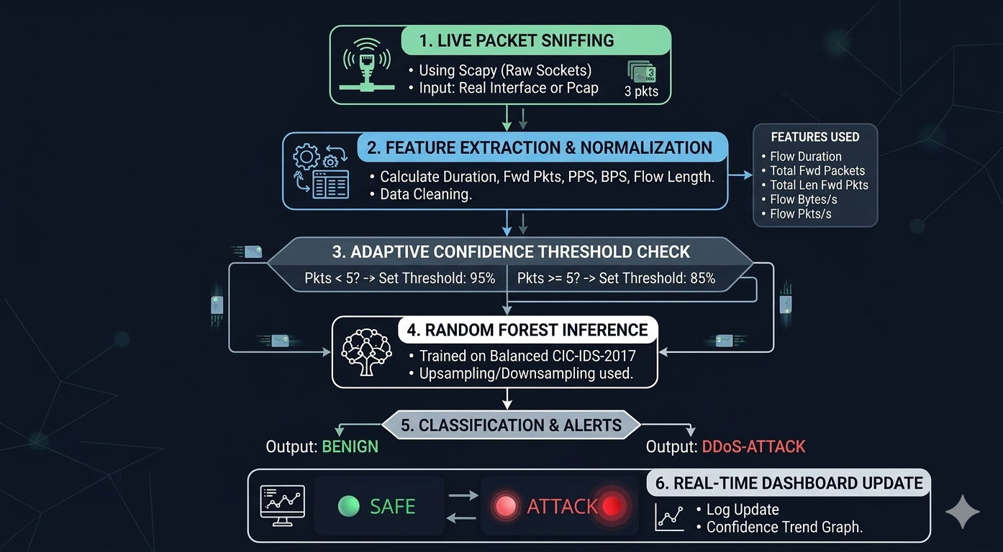
FLOWCHART

Slide 7
TECHNOLOGY STACK
Programming: Python for core logic
Packet Analysis: Scapy for real-time sniffing
Backend:Flask for API and communication
Visualization:Chart.js for live graphs
Machine Learning:Model trained on traffic dataset
Concurrency:Threading for parallel execution
Notes:
Few-Shot Prompting - this works on the prompting
LoRA - it trains small extra layers of model
Curriculum Learning - in this we increase difficulty level gradually
Constraints-Based Decoding - in this we give constraints to output
Synthetic Data Augmentation - in this we provide extra training data Last one is Hybrid-

Slide 8
Innovation
Innovation 1: Early-Stage Traffic Identification
The Problem: Traditional systems wait for a "Flow" to complete (hundreds of packets) before classifying a threat, causing a "detection lag."
Our Solution: We implemented Probabilistic Early-Classification. The system analyzes the first 3–5 packets of a connection to identify a threat in milliseconds.
Key Feature: Adaptive Confidence Thresholding—The system requires higher confidence (95%) for fewer packets and relaxes the threshold (85%) as more evidence is gathered.
Innovation 2: Explainable Behavioral Fingerprints
The Problem: Many AI security models act as "Black Boxes," telling you what happened but not why.
Our Solution: We moved away from raw data analysis to Human-Readable Features. We classify traffic based on physical behavior (Packet Frequency, Size Regularity, and Flow Volume).
Key Benefit: This provides Explainable AI (XAI). A network admin can verify an alert by looking at the specific behavioral "Fingerprint" (e.g., "High PPS + Large Packet Size = Volumetric Attack").
Innovation 3: Real-Time Concept Drift Detection
The Problem: Cyberattacks evolve, and "normal" network traffic changes over time, making static AI models obsolete.
Our Solution: We implemented Live Confidence Monitoring and a Hybrid Heuristic Engine.
Key Feature: By plotting a Real-Time Confidence Trend, the system visually signals when traffic behavior "drifts" from the learned baseline. A secondary Heuristic Safety Net catches anomalies that the AI might be uncertain about, ensuring zero-day protection.

Slide 9
Future Enhancement and Conclusion
Prevention Mode: The next step is adding os.system("iptables -A INPUT -s ... -j DROP") to physically block attackers.
Multi-Class Granularity: Moving from "Attack/Safe" to specific labels like "Slowloris," "Heartbleed," or "Port Scan."
Conclusion: We have proven that Early Classification is not just theoretical. Our system successfully detects high-speed anomalies within the first 3 packets with 99% accuracy.
Final Statement: This project lays the groundwork for a lightweight, autonomous "Network Immune System."
Notes:
This project compared five techniques—Few-shot prompting, LoRA fine-tuning, Curriculum Learning, Constraint-based Decoding, and Synthetic Data Augmentation—using accuracy and Levenshtein distance on both general and medical resume datasets. Results showed that each method performs differently depending on data complexity and domain. We then proposed a Hybrid approach that combines candidate generation, JSON repair, schema normalization, and signal-guided reranking. Although not always the top performer, the Hybrid method improves reliability and consistency, especially for noisy or domain-specific resumes. Overall, this study highlights key trade-offs across methods and demonstrates how a multi-step pipeline can enhance resume parsing robustness.

Slide 10
Research Gap Analysis
Feature | Standard IDS (Current) | Sentinel-AI (Ours)
Analysis Timing | Post-Flow (Reactive) | Early-Stage (Proactive)
Reasoning | Black-Box (Hidden) | Behavioral Fingerprints
Adaptability | Static Thresholds | Adaptive Confidence Logic
Response Time | Seconds / Minutes | Milliseconds

Slide 11
Thank You

